Slide 1
SHRIKE Tactical Robotics
Science friction

Slide 2
What is the SHRIKE System?
Robotics | Computer | Programming | bluetooth
Independent Propulsion with 4 Planetary Geared Motors | Measurement Accuracy. Filtered Data | Optimized Test Time and Distance | Range of Up To 330 m
Dual Zinc-Oxide Tracks | Samsung Tablet Computer and APP Included | Standardized 100 Force Samples Every Second | Transfer Data to APP For Analysis and Reports
Redesigned Multi-Surface Skid Plates | No Human Error or Bias | Electronic Strain Gauge/Load Cell Measurement | Secure, Safe, Fast

Slide 3
Highlights and System Specifications

Slide 4
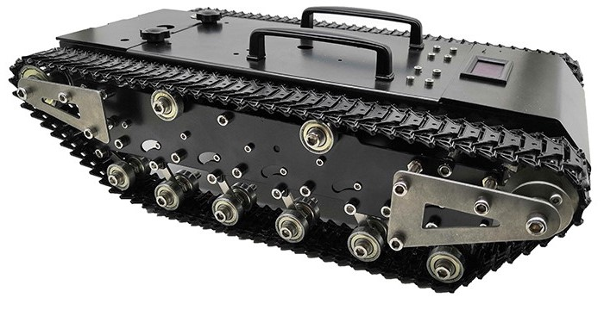
Circuitry Bay and Battery
On/Off Locator Beacon
Bluetooth
Skid Plate Bay
Six Sets of Independent Suspension
Heavy Duty Zinc-Oxide Tracks
22 lbs (10 kg)
Weatherproof
General Arrangement

Slide 5
SHRIKE Advantages
Guaranteed Optimum Pull Angle
Pre-Programmed Test Time and Distance
100 Force Readings Per Test
Bluetooth Data Transfer
Portable – Transport Case Included
Wall/Car Chargers
Samsung Tablet and APP Included
Fully Warrantied
Expandable

Slide 6
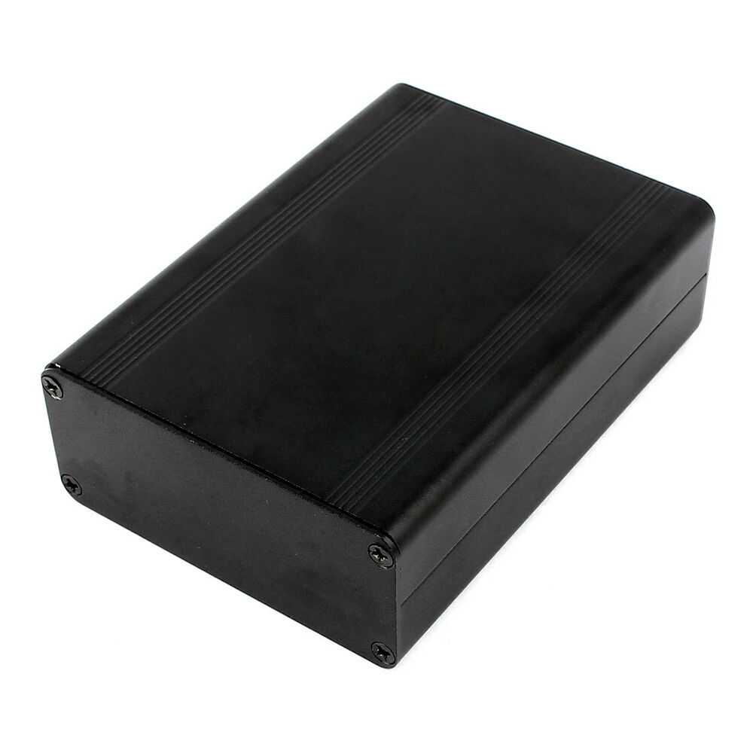
SHRIKE
Redesigned
Re-engineered Skid Plate with Multiple Interchangeable Pads

Slide 7
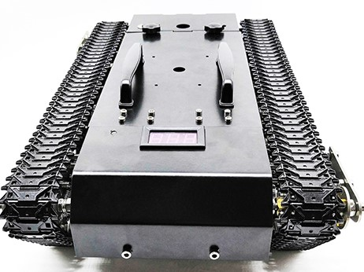
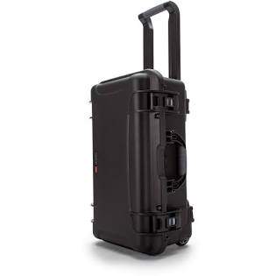
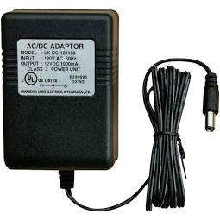
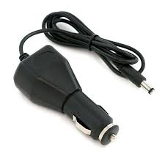
Included With SHRIKE
Samsung Tablet PC With App
Analysis Program With Multi Graph Overlay
NATO Approved Carry Case
Car/Wall Chargers

Slide 8
Never Pull a Drag Sled Again!
Robotic
Never Worry About Pull Angle, Pull Velocity or Distance
No Paper, Clipboards or Spring Scale
Self Calibrating or Manual Calibration
All Weather Capable
High Sampling Rate
Built to Exacting Engineering Standards

Slide 9
Questions
sales@ktssystem.com
604-812-5393
17665 66A Ave #504, Surrey, BC
604-576-4422
Bruce Cardoza Tom Watters Phil Noonan

